Slide 1

Genetics
Chapter 6.2

Slide 2
6.2 Process of Meiosis
After this section you will be able to……
Explain each step of meiosis
Compare mature gametes with immature gametes
Compare mitosis and meiosis

Slide 3

TEKS
6G - recognize the significance of meiosis to sexual reproduction

Slide 5
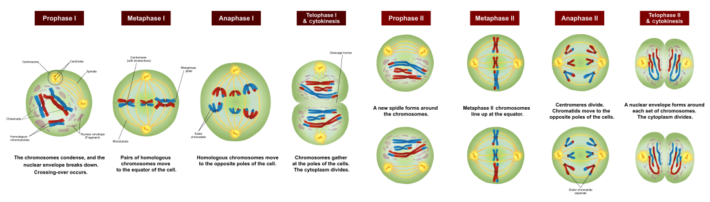
Process of Meiosis (Meiosis I)

Slide 6
Process of Meiosis (Meiosis II)

Slide 7
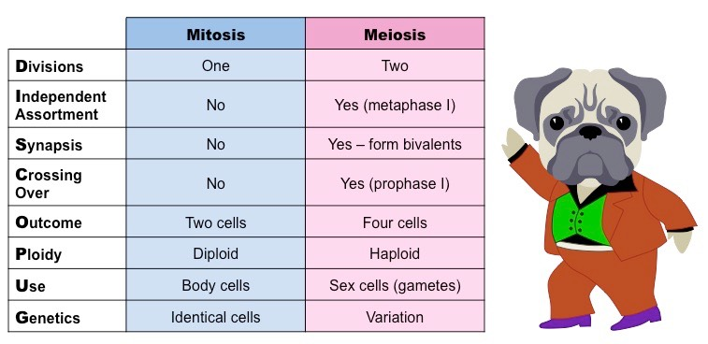
Mitosis vs Meiosis

Slide 8
Mature vs Immature Gametes
Immature gametes are haploid cells that are not yet capable of undergoing fertilization. During gametogenesis a sperm cell loses much of its cytoplasm and gains a flagella. The egg cell gets the majority of the cytoplasm and organelles. For egg production, only one of the produced cells become an egg. The rest become polar bodies that are eventually broken down.

